Slide 1

Basic Mark Up Knowledge
HTML , CSS
Any CSS Framework like bootstrap, foundation

Slide 2
Basic Knowledge
JavaScript
Any CSS Framework like bootstrap, foundation

Slide 3
React learning strategy
React front end project structures
JSX
Functional components
Class components
State management, props
Conditional rendering
React List
React ref
React router
React context
Hooks for functional components
React packages for front end development
NPM package implementation strategy

Slide 4
Project Structure
Create a new react front end project
Discover the file folders inside

Slide 5
JSX
JSX(JavaScript Extension)
Allows writing JavaScript code that looks like HTML

Slide 6
Functional Components
Create & understand
Passing Props
Working with Hooks

Slide 7
Functional Components Hooks
useState
useEffect
useRef
useContext
useReducer,
useCallback,
useMemo,
useImperativeHandle,
useLayoutEffect
useDebugValue.

Slide 8
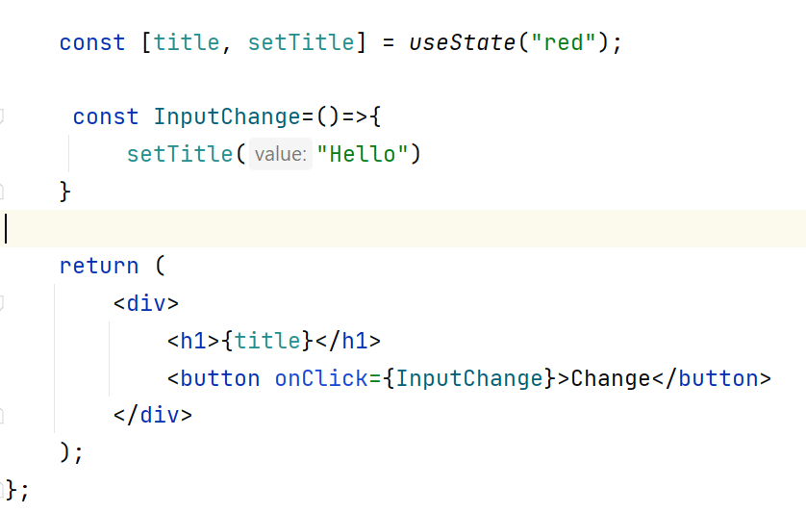
Functional Components Hooks (useState)

Slide 9
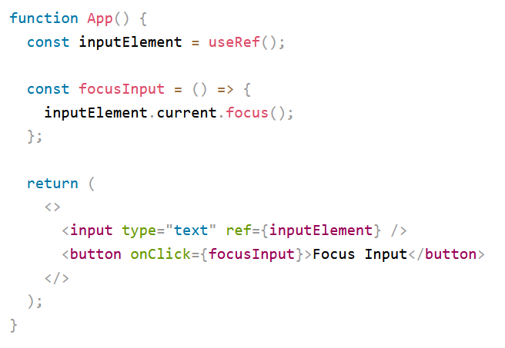
Functional Components Hooks (useRef)
In general, we want to let React handle all DOM manipulation.
We can add a ref attribute to an element to access it directly in the DOM.

Slide 10
Class Components
Create & Structures
Using Props
Using State
Conditional Rendering
Ref
Component Did Mount

Slide 11
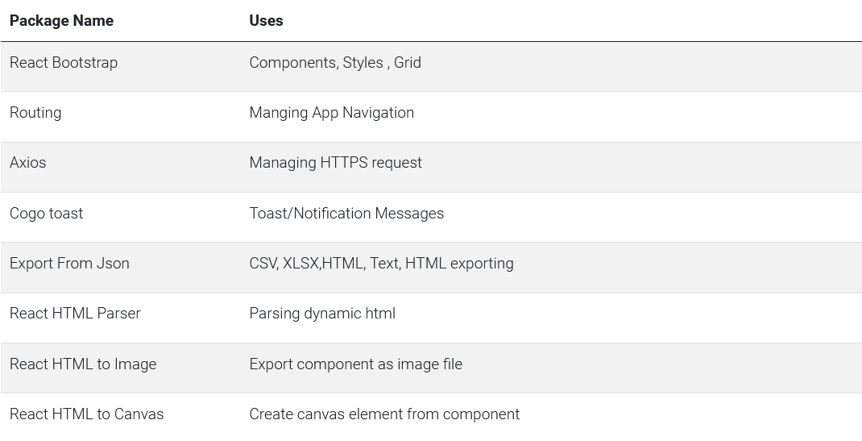
Essential Packages

Slide 12
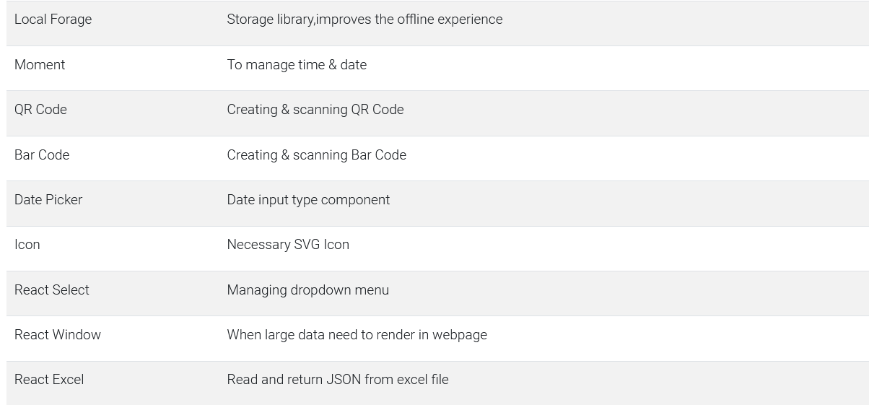
Essential Packages

Slide 13
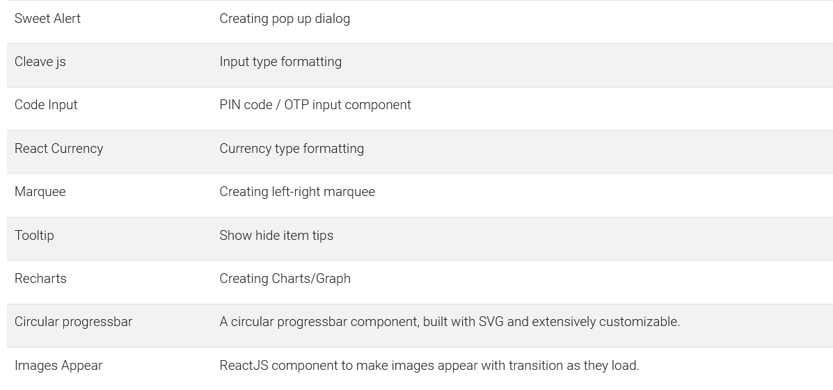
Essential Packages

Slide 14
Package Implementation
Discover Package Inside NPMJS.COM
Discover Package Inside NPMJS.COM
Discover Package Inside NPMJS.COM
Discover Package Inside NPMJS.COM
Discover Package Inside NPMJS.COM

